Slide 1
JOURNAL CLUB PRESENTATION
PRESENTORS:
DR. SILAS GAMBA
DR. JAMES MASANJA
DR. JAMES JINGU DATE: 24th JULY 2026
Notes:
Goodmorning and welcome to todays journal club presentation , where I . First part

Slide 2
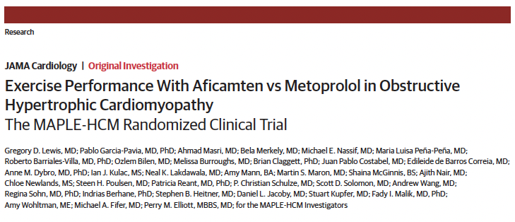
Phase 3 RCT, active control done from June 2023 to March 2025
JAMA Cardiol. doi:10.1001/jamacardio.2026.1730
Published online June 17, 2026.
Notes:
This was a prespecified secondary analysis of the MAPLE-HCM study, a phase 3, randomized, active-control trial conducted from June 2023 to March 2025
At 71 sites in North America, South America, Europe, Israel, and China.

Slide 3
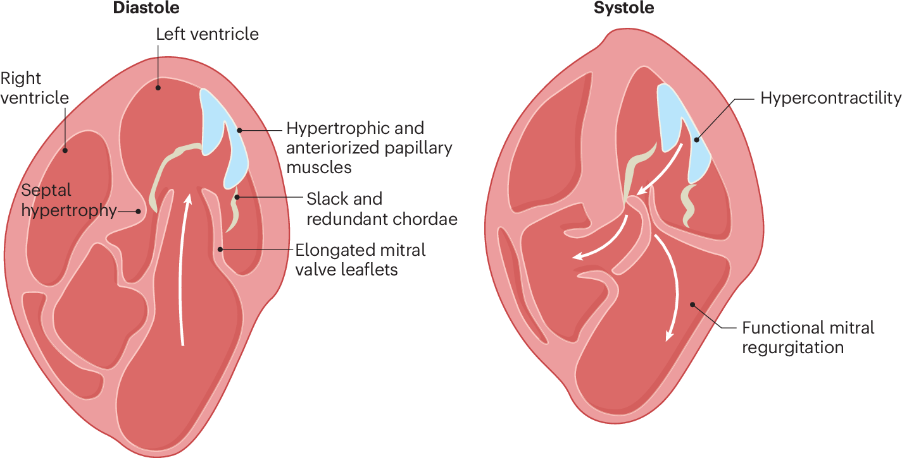
INTRODUCTION
HCM is a autosomal - dominant genetic disorder
Is characterized by LVH (often asymmetric) unexplained by other condition (e.g., HTN, aortic stenosis, amyloidosis) with a non-dilated LV
Is often silent until presents with exertional symptoms, AF, HF, or sudden death
Ommen SR, Ho CY, et al. 2024 AHA/ACC/AMSSM/HRS/PACES/SCMR Guideline for the Management of Hypertrophic Cardiomyopathy. Circulation. 2024;149:e1239–e1311. doi:10.1161/CIR.0000000000001250.
Notes:
Unexplained left ventricular hypertrophy (often asymmetric examples: papillary muscles, the septum) with a non-dilated LV and preserved or increased EF
It is diagnosed primarily by echocardiography/CMR after excluding loading conditions (e.g., hypertension, aortic stenosis) and phenocopies/mimics: cardiac amyloidosis, Anderson-Fabry disease, glycogen storage diseases, athlete's heart
2024 AHA/ACC guideline emphasizes routine 3-generation family history and genetic/family screening.

Slide 4
EPIDEMIOLOGY
Worldwide prevalence of around 1:500, but only minority of cases (10%) are identified clinically; (prevalent up to 70% of SCD cases)
In 2024 IMHOTEP registry from South Africa and Mozambique, HCM represented 70 of 665 cardiomyopathy cases (10.5%)
In Tanzania, Maro et al 2006 reported 0.19% prevalence among 6680 patients referred for ECHO at MNH
Maro EE, Janabi M, Kaushik R. Clinical and echocardiographic study of hypertrophic cardiomyopathy in Tanzania. Trop Doct. 2006;36:225–227. doi:10.1258/004947506778604904.
Notes:
Although the development of modern cardiovascular imaging with echocardiography >50 years ago increased in diagnosis even in Africa, still it’s the minority of cases that are identified
Adaya Circulation 2019 Chief Coroner of Ontario database encompassing all deaths attended by the coroner, we identified all HCM-related SCDs in individuals 10 to 45 years of age between 2005 and 2016 (70 million person-years)
IMHOTEP was a small pilot study this tertiary referral registry does not reflect population prevalence and likely underestimates asymptomatic HCM as it looked at those with symptoms. incident (newly diagnosed) and prevalent (existing) cases were recruited (October – December)
The cited study from Tanzania is form single centre, selection bias as it centred at hospital, prevalence may be more or less now factoring in that the majority of patient can be asymptomatic as will see.

Slide 5
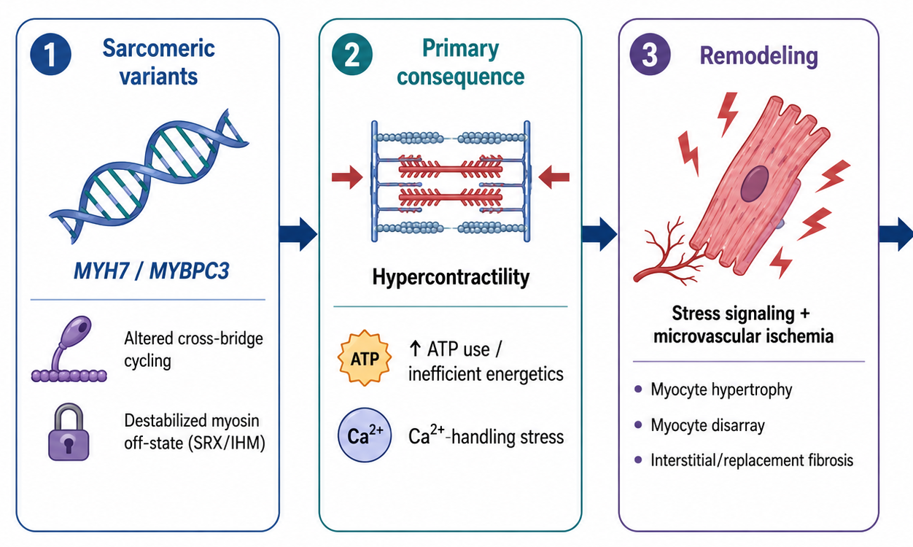
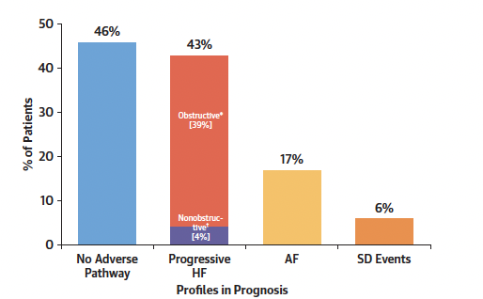
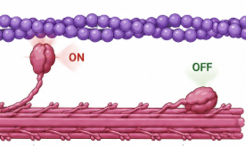
PATHOGENESIS
Maron BJ, Desai MY, Nishimura RA, et al. Diagnosis and Evaluation of Hypertrophic Cardiomyopathy: JACC State-of-the-Art Review. J Am Coll Cardiol. 2022;79(4):372–389. doi:10.1016/j.jacc.2021.12.002
Notes:
More than 1,400 mutations varients encoding eight sarcomere proteins sarcomere genes have been linked to hypertrophic cardiomyopathy
β-cardiac myosin is an ATPase motor protein that uses ATP to drive actin–myosin cross-bridge cycling and cardiac contraction.
Mutations, especially in MYH7 and MYBPC3, translation changes where more myosin heads are active, increasing hypercontractility, ATP use, and oxidative stress.
The energetic/Ca²⁺-handling stress triggers downstream stress-signaling and myocardial remodeling, leading to myocyte hypertrophy, fibrosis, and microvascular ischemia as muscle growth exceeds its blood supply.
Septal hypertrophy, systolic anterior motion, and hypercontractility produce dynamic LVOT obstruction, while remodeling with fibrosis causes diastolic dysfunction, arrhythmias, heart failure, and sudden cardiac death from ventricular tachyarrythmias
Ntusi et al. (2016) conducted a prospective longitudinal cohort study of 43 South African HCM patients and found a 28.6% genetic diagnostic yield, with all pathogenic variants occurring in MYH7 and MYBPC3, mirroring the predominant sarcomeric genes identified in European populations, although with a lower overall yield (28.6% vs 40–70%)

Slide 6
EVALUATION
Presence of crescendo-decrescendo systolic murmur from LVOTO
On CMR/ECHO: maximal end diastolic LV thickness≥15 mm anywhere in LV or (13–14 mm if 1st degree relatives has HCM)
Exercise limitation occur if resting/provoked LVOT gradient >50 mmHg
Cardiopulmonary exercise testing identifies what exactly during fails (i.e ventilation, O₂ uptake, CO₂, HR, BP )— from start, maximal effort to recovery, with low capacity strongly prognostic of adverse events
Maron BJ, Desai MY, RA, et al. Diagnosis and Evaluation of Hypertrophic Cardiomyopathy: JACC State-of-the-Art Review. J Am Coll Cardiol. 2022;79(4):372–389. doi:10.1016/j.jacc.2021.12.002
Notes:
In patients with HCM, exercise stress testing is safe and provides information on the severity and mechanism of functional limitation. Particularly when combined with simultaneous analysis of respiratory gases (ie, cardiopulmonary exercise test [CPET]), lower exercise capacity is strongly prognostic of adverse events, including death, HF, and ventricular arrhythmias in both adults and children.
Reduced CO due to Dynamic LVOT obstruction (from factors like systolic anterior motion of the mitral valve: where they coaptate anterior not closer to lateral wall which is normal). It also increases with contractility and reduced preload.
Secondary mitral regurgitation + pulmonary hypertension reduces ventilatory efficiency (as the congestion impairs exchange, and VQ mismatch).
Myocardial ischemia (demand supply mismatch as hypertrophied muscle mass exceeds intramural coronaries supply) and diastolic dysfunction (reduced LV compliance from fibrosis and hypertrophy) impairs stroke-volume reserve i.e preload
Chronotropic response becomes critical because heart-rate augmentation is a major contributor to exercise cardiac output.
Peak VO2 is the highest rate of oxygen your body uses during a specific exercise test.

Slide 7
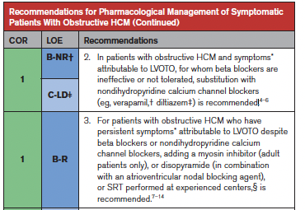
MANAGEMENT
Evolved from symptom control to durable relief of LVOTO, SCD prevention
1980s: negative inotropes (bb → CCBs)
2010s: Septal Reduction Therapy + ICD + AF anticoagulation reduce “fatal pathways” (obstruction HF, SCD, embolism)
Ommen SR, Ho CY, et al. 2024 AHA/ACC/AMSSM/HRS/PACES/SCMR Guideline for the Management of Hypertrophic Cardiomyopathy. Circulation. 2024;149:e1239–e1311. doi:10.1161/CIR.0000000000001250.
Notes:
Implantable Cardioverter-Defibrillator.
The 2024 AHA/ACC guideline’s recommendation for a cardiac myosin inhibitor after inadequate response to first-line beta-blockers or nondihydropyridine calcium-channel blockers was based principally on mavacamten evidence and availability. It does not mean aficamten was ineffective; it simply had not yet crossed the required sequence of: Phase 3 evidence → regulatory approval → clinical availability → guideline evidence review and update.
MAPLE-HCM now provides stronger evidence for aficamten than was available during guideline development, showing aficamten monotherapy was superior to metoprolol for exercise capacity and several clinical and haemodynamic outcomes; pivotal comparative evidence and FDA approval only emerged in 2025. It is therefore likely to be considered in a future focused update or full guideline revision.

Slide 8
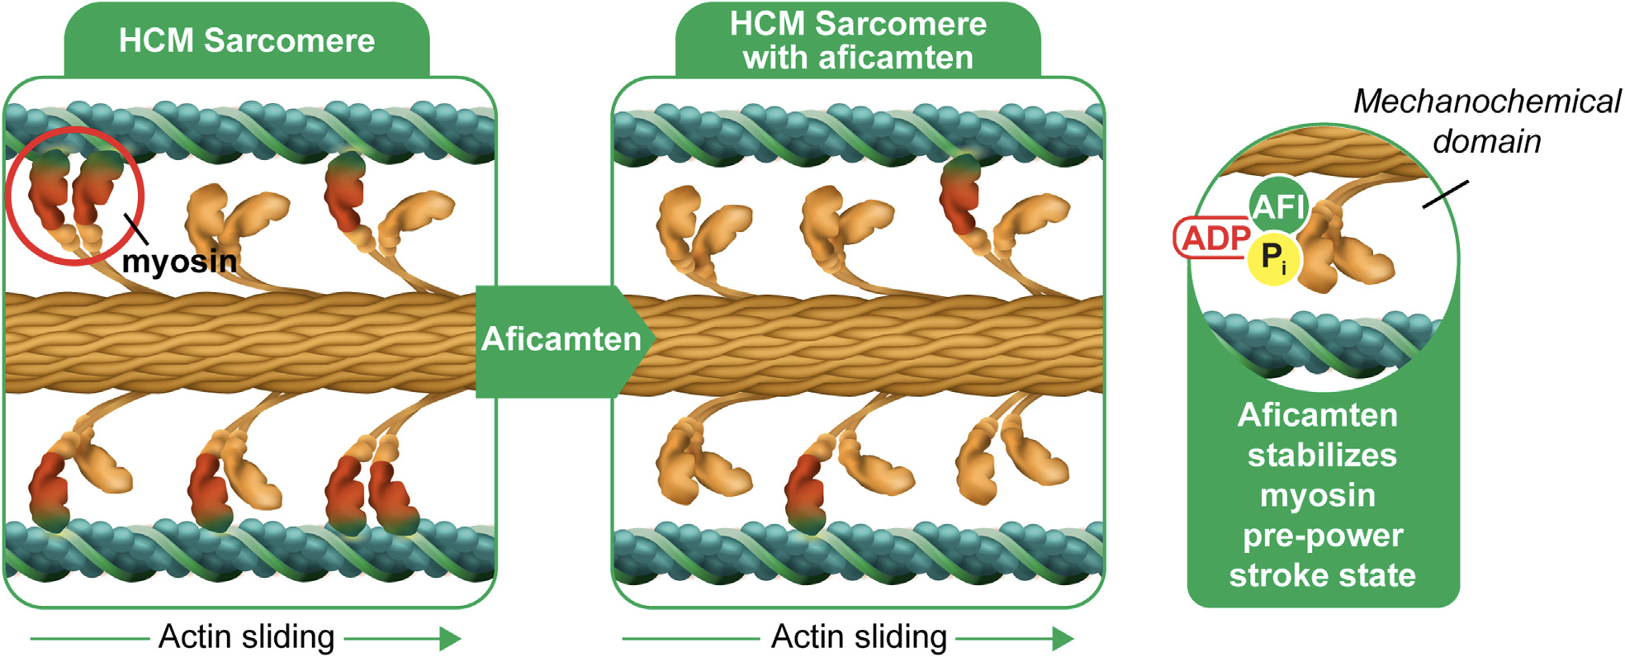
AFICAMTEN
PD: No effect on HR. SE: high dose - reduce LVEF, Dizziness and Fatigue
PK: Shorter predictable t½ 75–85; Hepatic metabolism, biliary excreted
Maron BJ, Desai MY, Nishimura RA, et al. Diagnosis and Evaluation of Hypertrophic Cardiomyopathy: JACC State-of-the-Art Review. J Am Coll Cardiol. 2022;79(4):372–389. doi:10.1016/j.jacc.2021.12.002
Notes:
β-cardiac myosin itself is an ATPase enzyme. It hydrolyzes ATP to generate force during actin–myosin cross-bridge cycling. AFI by reversibly binding to cardiac myosin at anllosteric site and slows this hydrolysis (organic phosphate release) and more myosin are in off state not interacting with actin
stabilizing the myosin pre–power stroke state, and reducing excessive myosin-actin cross-bridges decreases myocardial hypercontractility which is the driver of disease manifestation as complain
Has no effect on HR
The shorter half-life is probably aficamten’s clearest practical pharmacological distinction. Mavacamten can persist for several weeks, particularly in CYP2C19 poor metabolizers, whereas aficamten’s effect should resolve more rapidly following interruption. However, this theoretical convenience should not be interpreted as proven clinical superiority. Both drugs can cause systolic dysfunction and require careful echocardiographic titration.
Aficamten: why this specific myosin inhibitor?
Next-in-class cardiac myosin inhibitor designed for easier dose management and a wider therapeutic window.
Half-life about 3.4 days - shorter than mavacamten, allowing faster adjustment if LVEF falls or symptoms change.
Low pharmacokinetic variability and metabolism through multiple CYP pathways - lower likelihood of clinically relevant drug-drug interactions.
Shallow dose-response relationship - intended to reduce abrupt excessive negative inotropy.
Phase 2/3 development showed symptom, LVOT-G, pVO2, and biomarker improvements when added to standard therapy.

Slide 9
LITERATURE REVIEW
TRIAL; YEAR | DESIGN | KEY FINDINGS | GAPS
EXPLORER-HCM Olivotto et al 2020 68 centres; North America and Europe | Phase 3 double-blind RCT; n=251 symptomatic oHCM, 30 weeks mavacamten vs placebo alongside SoC- βB or CCB PE: ≥1.5 mL/kg/min increase in pVO₂ with ≥1 NYHA-class improvement | Primary endpoint: 37% vs 17%; difference 19.4%, P=0.0005; NYHA improvement occurred in 65% vs 31% P=0.0006 | Placebo—not active-treatment—comparison Tested as add-on therapy

Slide 10
LITERATURE REVIEW
TRIAL; YEAR | DESIGN | KEY FINDINGS | GAPS
SEQUOIA-HCM Maron et al 2024 North America, Europe & China | Phase 3 double-blind RCT; n=282, 24 weeks Aficamten vs placebo; PE: pVO₂ change from baseline, ≥1 NYHA-class | Peak VO₂ difference +1.74 mL/kg/min; 95% CI 1.04–2.44; P=0.000002. NYHA class improved in 58.5% vs 24.3% P=0.001. | Placebo add-on comparison; no direct comparison with first-line, CPET measures not fully assessed
FOREST-HCM SoC-withdrawal analysis Masri et al 2024 | Open-label extension; n=136 with oHCM, followed ≥24 weeks; Withdrawal (≥ 50% dose of ≥1 med after ≥4 weeks on aficamten | Withdrawal successful in 45.8%, p<0.0001 achieved aficamten monotherapy No group differences in NYHA response, p=0.70; | No randomized control; open-label and attrition bias limits definite proof
Notes:
Thre have been two recent trials on aficamten 1 phase 3 and 1 phase 2
Across all the literature comprehensive CPET measures of exercise performance have not been previously compared and changes in oHCM disease severity correlation with changes in pVO2 were not studied despites the evidence that lower exercise capacity is strongly prognostic of adverse events, including death, HF, and ventricular arrhythmias in both adults and children.

Slide 11
PROBLEM STATEMENT
In obstructive hypertrophic cardiomyopathy, exercise intolerance is common, substantially limits daily functioning, and is strongly associated with adverse outcomes
However, current first-line beta-blocker therapy may reduce heart rate and inadvertently exercise capacity, while evidence supporting cardiac myosin inhibitors as initial monotherapy remains limited

Slide 12
RATIONALE
Cardiac myosin inhibitors directly targeting sarcomere hypercontractility, improve obstruction without the cost of blunting heart-rate response and limiting exercise capacity like β-blockers
The study directly compared aficamten with metoprolol using CPET measures to determine which produced better physiological adaptation during exercise and changes in oHCM disease severity

Slide 13
BROAD OBJECTIVE
To evaluate the effect of treatment with aficamten compared to metoprolol on comprehensive measures of exercise capacity on cardiopulmonary exercise testing in participants and changes disease severity among patients with symptomatic obstructive HCM
Notes:
The key issue: does treating the sarcomere preserve the patient’s ability to exercise better than blunting adrenergic drive?
If a CMI works only as add-on therapy, beta-blocker adverse effects remain part of the treatment burden.
If a CMI works as monotherapy, it may become a first-line option for newly diagnosed symptomatic oHCM.
Monotherapy may simplify treatment and avoid chronotropic limitation.
A direct comparison is necessary because placebo add-on trials cannot prove superiority over standard care.

Slide 14
SPECIFIC OBJECTIVES
To evaluate:
Effect of Aficamten vs Metoprolol on pVO2 and CPET parameters
Effect of Aficamten vs Metoprolol on Symptoms (by NYHA class)
Effect of Aficamten vs Metoprolol on Participant health status ( by KCCQ)
Effect of Aficamten vs Metoprolol on NT-proBNP level
Effect of Aficamten vs Metoprolol on post- Valsalva LVOT gradient
Notes:
Exercise limitation is life-altering: activities of daily living, work capacity, and quality of life decline.
Objective exercise capacity is prognostic: lower pVO2 predicts worse outcomes in HCM cohorts.
Therefore, an intervention that improves exercise physiology may be clinically meaningful beyond symptom scores.
NYHA class improvement
Change in KCCQ-CSS (health status)
Change in NT-proBNP (myocardial stress)
Change in post-Valsalva LVOT gradient

Slide 15
METHODOLOGY

Slide 16



METHODOLOGY
175 participants were randomized, followed from 30th June 2023 to March 2025
71 sites across North America, South America, Europe, Israel, and China
Phase 3 randomized, double-dummy, double-blind, active-control trial

Slide 17
…contd
INCLUSION CRITERIA
EXCLUSION CRITERIA
Symptomatic obstructive HCM
NYHA functional class II–III
LVOT gradient ≥30 mm Hg at rest or ≥50 mm Hg post Valsalva maneuver
KCCQ-CSS ≤ 90 at screening visit 2
History of AF
Medical need prohibiting β-blockers/CCB discontinuation
Septal reduction therapy within 6 months of screening
SBP >160 mmHg, HR>100bpm
Notes:
Evidence of left ventricular outflow tract obstruction:
Resting LVOT gradient ≥30 mmHg, and/or
pVO2 - peak oxygen uptake,
Objective exercise intolerance
Evidence of left ventricular outflow tract obstruction:
Resting LVOT gradient ≥30 mmHg, and/or
Post-Valsalva LVOT gradient ≥50 mmHg.
pVO2 - peak oxygen uptake; RER- respiratory exchange ratio.
Objective exercise intolerance

Slide 18
RANDOMIZATION AND STRATIFICATION
Randomization
1:1 Assignment via web-response system
Aficamten +
placebo
24-week
outcome assessment
Eligible
participants
Metoprolol +
placebo
Stratification factors
• CPET modality: treadmill or upright cycle ergometry
• Duration of oHCM diagnosis.
• Previous pharmacologic therapy
Notes:
Study personnel and participants remained blinded through database lock.
Blinding extended to treatment assignment, dosing, NT-proBNP levels and echocardiogram measures.
Stratification factors were subsequently used as covariates in the ANCOVA model

Slide 19
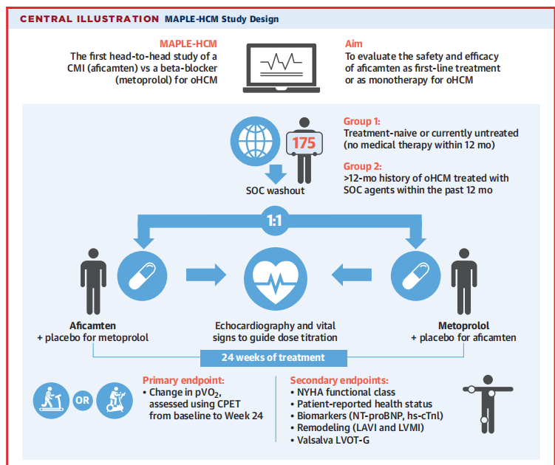

Slide 20
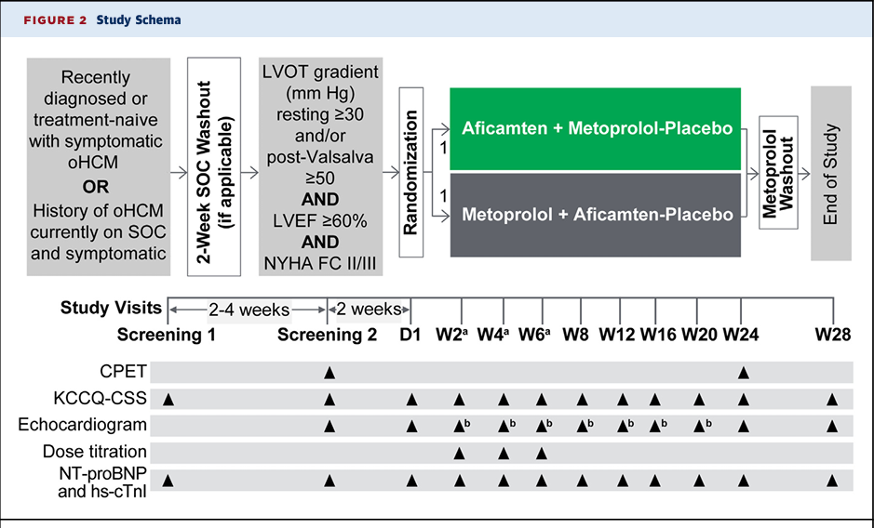
Notes:
dose escalation x 3 weeks.
HR > 55b/m or <50b/m
SBP >90 or less than 90
LVEF > 55 40-49 reduce < 40. tempo discontinue
POST VALSAVA LVOT Gradient > 30 or < 30

Slide 21
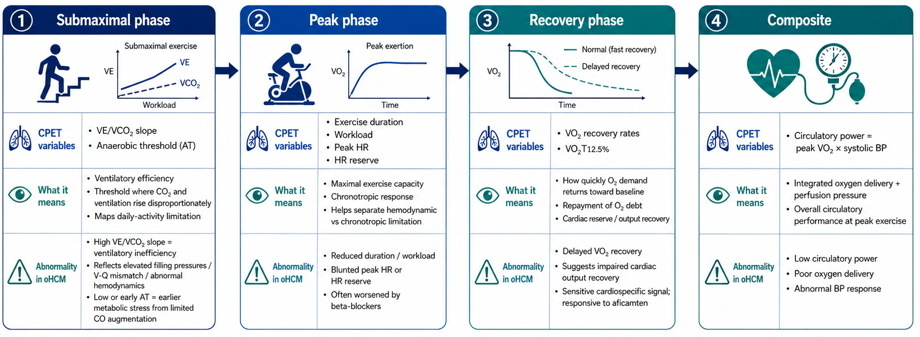
CPET DOMAINS
Notes:
The submaximal graphs reflect daily-activity physiology: a steeper VE/VCO₂ slope means inefficient ventilation from raised filling pressures, while an earlier anaerobic threshold shows reduced oxygen delivery at lower workloads. Why: LVOTO and diastolic dysfunction limit stroke-volume rise and increase pulmonary pressures.
The peak workload graph reflects maximal functional capacity: patients stop earlier because LVOT obstruction, impaired filling, and limited stroke-volume reserve restrict cardiac-output augmentation. Why: the heart cannot increase forward flow enough to match muscle oxygen demand.
The heart-rate graph assesses chronotropic reserve: a flatter response means the heart cannot raise cardiac output adequately, often because beta-blockers blunt sinus-node activation. Why: when stroke volume is fixed, exercise depends more heavily on heart-rate increase.
The recovery graph shows how quickly VO₂ falls: a slower decline indicates delayed restoration of cardiac output and prolonged repayment of the accumulated oxygen deficit. Why: impaired circulation during exercise leaves greater metabolic debt after stopping.
The composite panel shows circulatory power: peak VO₂ multiplied by peak systolic pressure combines oxygen transport with the ability to maintain systemic perfusion during exercise. Why: oHCM may impair both oxygen delivery and the blood-pressure response.
Overall, aficamten shifts these curves toward better performance by reducing sarcomeric hypercontractility and LVOT obstruction while preserving the physiological heart-rate response. Why: it improves haemodynamics without the chronotropic suppression produced by beta-blockade

Slide 22
METHODOLOGY
PRIMARY ENDPOINT
SECONDARY ENDPOINT
Peak oxygen consumption (Peak VO₂) measured by (CPET)
NYHA class improvement
Change in KCCQ-CSS (health status)
Change in NT-proBNP (myocardial stress)
Change in post-Valsalva LVOT gradient
Notes:
CPET-Cardiopulmonary testing,KCCQ-CSS(Kansas City Cardiomyopathy Questionnaire–Clinical Summary Score (KCCQ-CSS).
LVMI-Left Ventricular mass index, LAVI-left atrial volume index
Major adverse cardiac events (CV death, cardiac arrest, stroke, MI, CV hospitalization) and incidence of LVEF < 50%

Slide 23
STATISTICAL ANALYSIS
Software: STATA version 19, analyses performed by Brigham and Women’s Hospital Trials Center
ANCOVA model: treatment, randomization stratification factors (CPET modality, oHCM duration, prior therapy), and baseline value of the outcome as covariates
For 16 CPET variables, statistical significance threshold was P<.0031 after Bonferroni correction
Assumed Δ = 2.0 mL/kg/min in peak VO2 (aficamten vs. metoprolol)
N = 170 provides ≥ 90% power to detect the assumed difference with 2-sided type 1 error of 0.05)
Notes:
n - 170
but 175 candidate was enrolled- provide buffer, and increase precisions of data.

Slide 24
ETHICAL CONSIDERATIONS
All participants gave written informed consent before enrollment
IRB and ethics committee approval was obtained at each center
Conducted per Declaration of Helsinki and ICH Good Clinical Practice
Independent data monitoring committee reviewed unblinded data for monitoring

Slide 25
FUNDING AND CONFLICT OF INTEREST
MAPLE-HCM was funded by Cytokinetics
Cytokinetics representatives contributed to study design/conduct, data management, interpretation, manuscript preparation
Several authors reported consulting fees, research grants, employment or stock ownership related to Cytokinetics
Notes:
Appraisal point: industry sponsorship and author ties should be transparently acknowledged when interpreting the results.

Slide 26
RESULTS

Slide 28
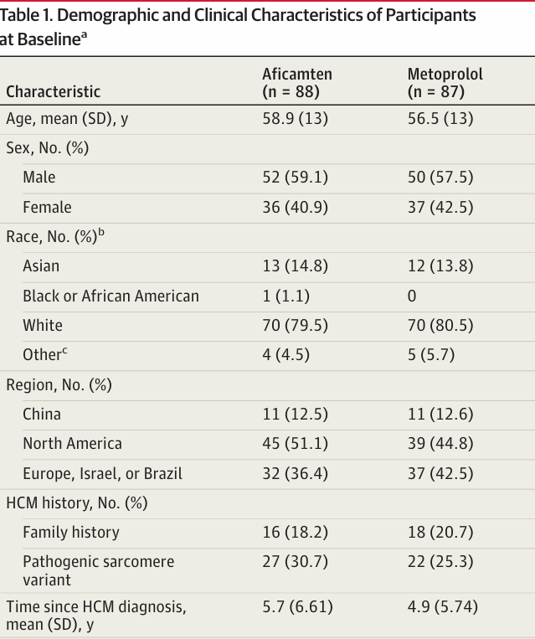
BASELINE CHARACTERISTICS

Slide 29
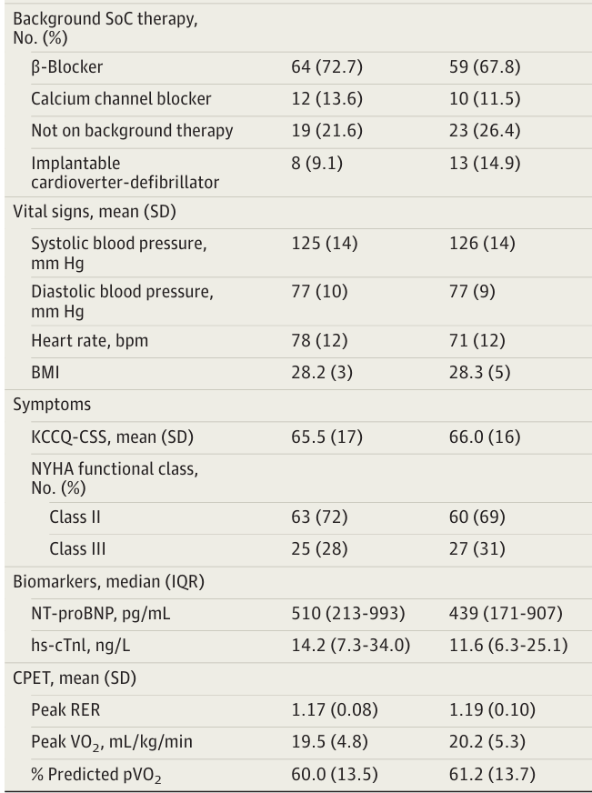
BASELINE CHARACTERISTICS

Slide 30
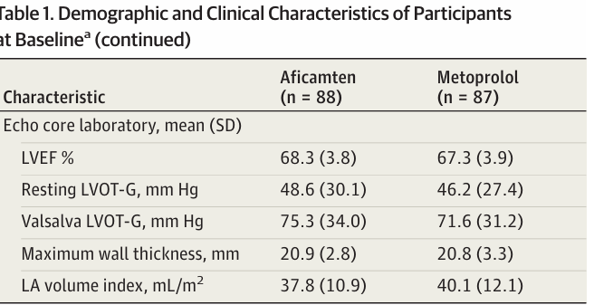
BASELINE CHARACTERISTICS

Slide 31
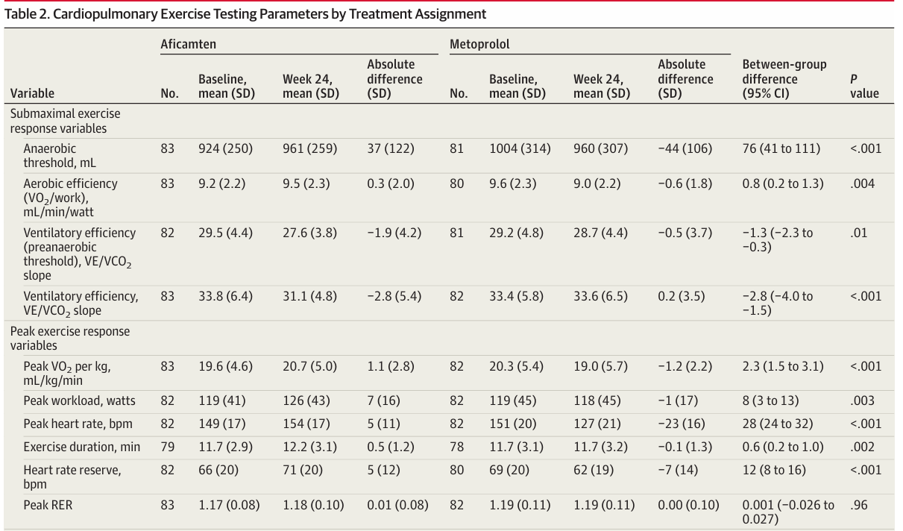
SUBMAXIMAL AND PEAK EXERCISE MEASURES

Slide 32
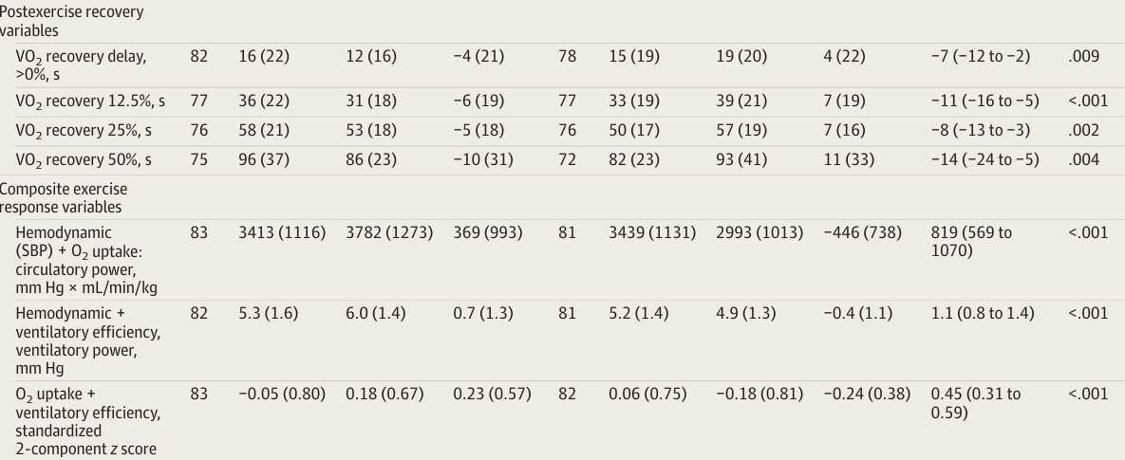
POST EXERCISE RECOVERY AND COMPOSITE EXERCISE RESPONSE VARIABLE

Slide 33
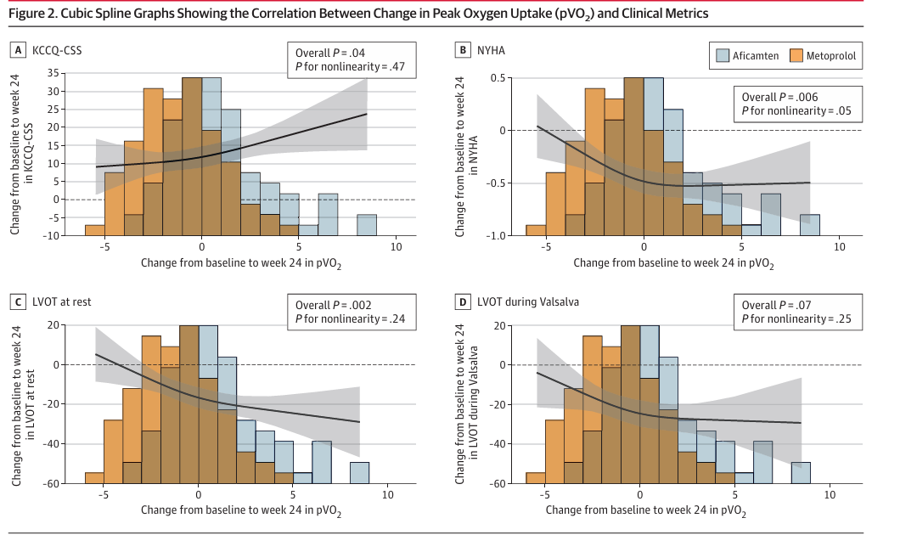
SECONDARY OUTCOMES

Slide 34
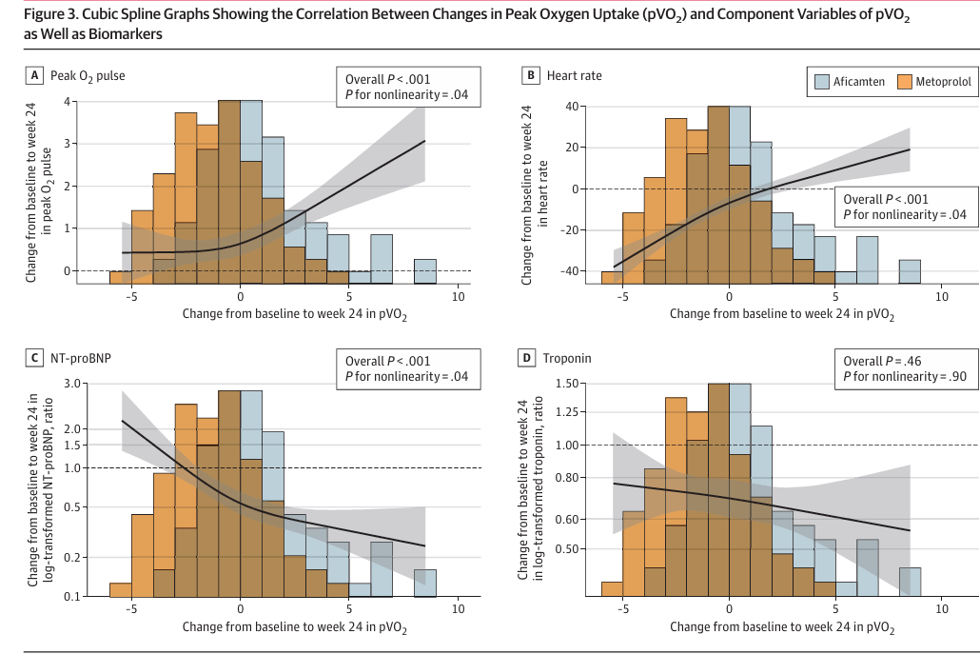
SECONDARY OUTCOMES

Slide 35
DISCUSSION
For over 50 years, β-blockers have been the standard first-line therapy for symptomatic OHCM by reducing LVOT
B-blockers may impair exercise cardiac output by causing chronotropic incompetence, with an average 23-bpm reduction in peak HR
MAPLE-HCM Trial Aficamten improved exercise performance across all stages of CPET 16 by targeting the underlying sarcomere hypercontractility (underlying pathology)

Slide 36
DISCUSSION
CLINICAL RELEVANCE OF PVO2 IN AFICAMTEN GROUP
Survival Benefit: Each 1 mL/kg/min increase in pVO₂ reduces mortality by 14% and adverse cardiovascular events by 13% in HCM
Aficamten was 6.8× more likely than metoprolol to produce a major improvement in exercise capacity(≥3ml/kg/min)
Exercise improvements correlated with better symptoms scores,functional class and biomarker trends

Slide 37
DISCUSSION
STRENGTH OF THE STUDY
Active Comparator: Directly compared aficamten with metoprolol, providing clinically relevant treatment insights
Strong Methodology: Used standardized CPET with centralized blinded analysis across 71 sites
Double-Dummy Design: Maintained blinding and reduced treatment assignment bias

Slide 38
DISCUSSION
LIMITATIONS
Short Duration: 24 weeks assessed exercise outcomes but not long-term clinical events
Selection Bias: Excluded patients unable to tolerate medication washout, limiting generalizability
Effect of Aficamten on exercise response in asymptomatic HCM remains to be studied

Slide 39
PAPER CRITIQUE
Title: Clear Objectives: Well stated Rationale: Well justified
Methodology:
✓ Robust randomized, double-blind, double-dummy design with active comparator
✓ Centralized CPET assessment improved reliability of outcomes
✓ Study funded by the drug manufacturer, with sponsor involvement
✓ Short follow-up limits evaluation of long-term clinical outcomes
Results: Well presented with clinically meaningful findings
Discussion: Based on the results
Conclusion: Long-term studies are needed

Slide 40
WHY THIS PAPER
Filling a 50-Year Evidence Gap
Challenging Expert Opinion: β-blockers have been the first-line therapy for symptomatic oHCM for over half a century, yet this recommendation was primarily based on expert opinion and small, uncontrolled studies
Potential Paradigm Shift to First-Line Therapy cardiac myosin inhibitors (Aficamten)

Slide 41
ACKNOWLEDGEMENT
Prof.Patrica Munseri
Msc fellow Cardiology
Mr. Peter Kimambi (Biostatistician)
Fellow Residents

